Slide 1
Collective influence algorithm
Jeroen Van Der Donckt

Slide 2
Overview
Collective influence algorithm
Programming language and IDE
Design
Breadth-first search
Optimization
Results
Visualization

Slide 3
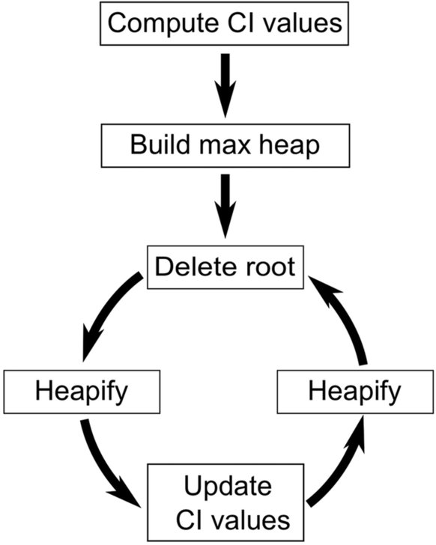
Collective influence algorithm
Notes:
First 2 parts only executed once
Loop:
Remove node with heighest CI
Heapifying heap from the new root (rightmost child)
Updating CI values and for each update heapify sub-trees of updated node
Loop ends when giant component is destroyed

Slide 4
Programming language and IDE
C#
Visual Studio 2015
Diagnostic tools
Console application
Visualization: QuickGraph
Graphviz
Notes:
Visual studio = integrated development environment (IDE) from Microsoft
QuickGraph = package that provides generic directed/undirected graph datastructures and algorithms for .NET, does not provide graph layout or visualization. It provides efficient brides between the data structures and existing graph layout libraries such as Graphviz

Slide 5
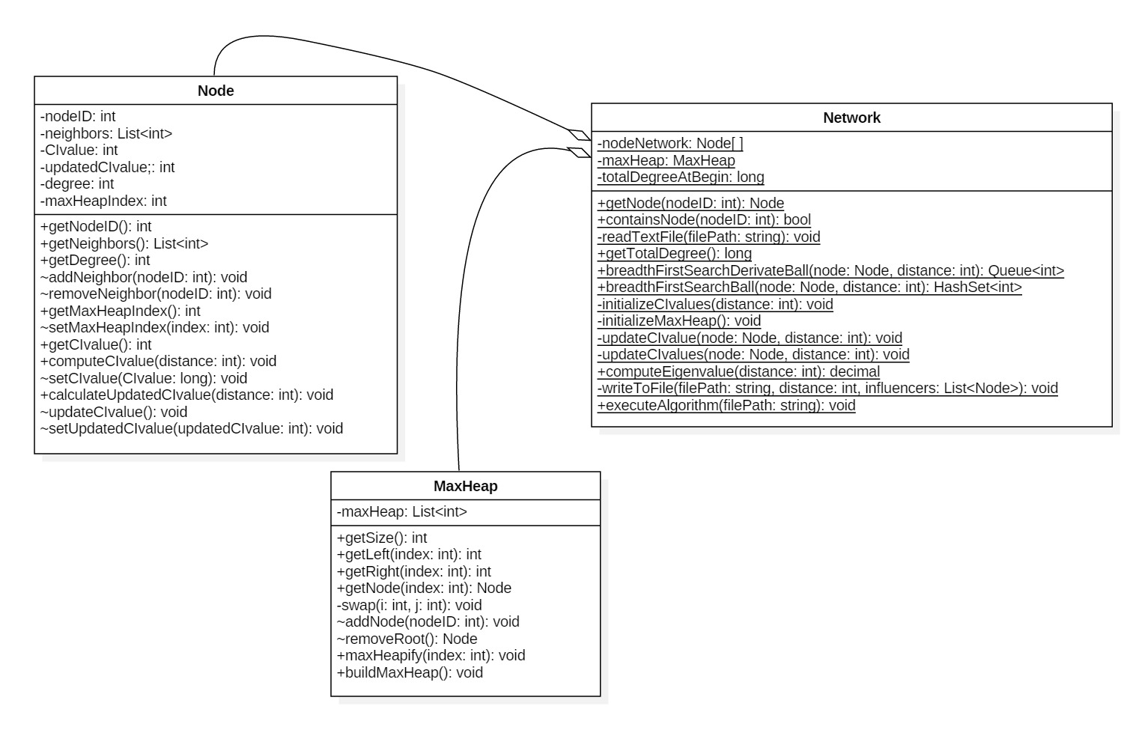
Design – Class diagram

Slide 6
Design – Data structure
Data Structure:
Network: nodeNetwork: Node[] //index = nodeID
Maxheap: maxHeap: List<int> //nodeID
Node: maxHeapIndex: int //index in maxheap
Notes:
Network: Node getNode(nodeID) -> nodeNetwork[index]
Maxheap: Node getNode(index) -> Network.getNode(maxHeap[index])

Slide 7
Breadth-first search
Queue<int> BFSDBall(node, distance)
queue = new Queue<int>();
visited = new HashSet<int>();
int newDegree = 0;
int depth = 0;
int temp = -1;
queue.Enqueue(node.ID);
visited.Add(node.ID);
int degree = 1;
while (depth < distance)
if (degree > 0)
temp = queue.Dequeue();
foreach (nID in getNode(temp).Neighbors)
if (!visited.Contains(nID))
queue.Enqueue(nID);
newDegree++;
visited.Add(nID);
degree--;
if (degree == 0)
depth++;
degree = newDegree;
newDegree = 0;
return queue;
Notes:
newDegree = number of nodes added to queue at certain depth

Slide 8
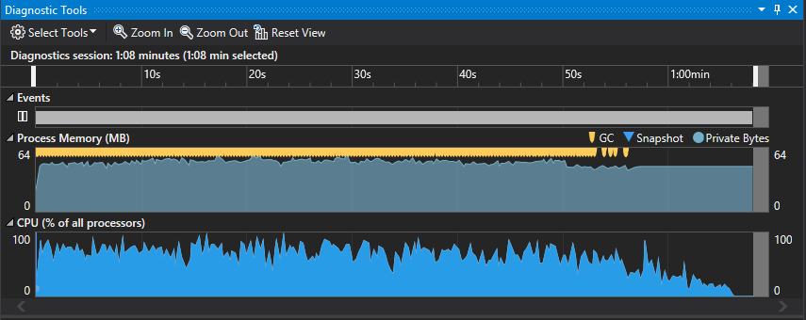
Optimization – Diagnostic tools
Email-Enron, depth 2

Slide 9
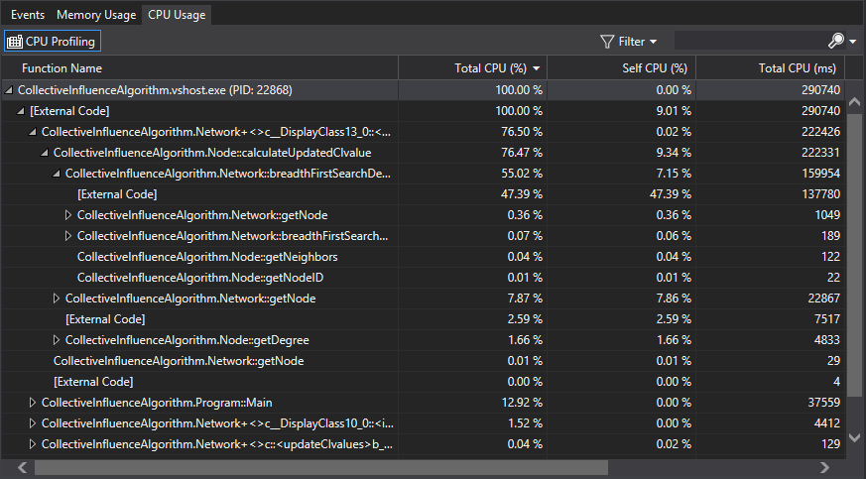
Optimization – Diagnostic tools
Email-Enron, depth 2

Slide 10
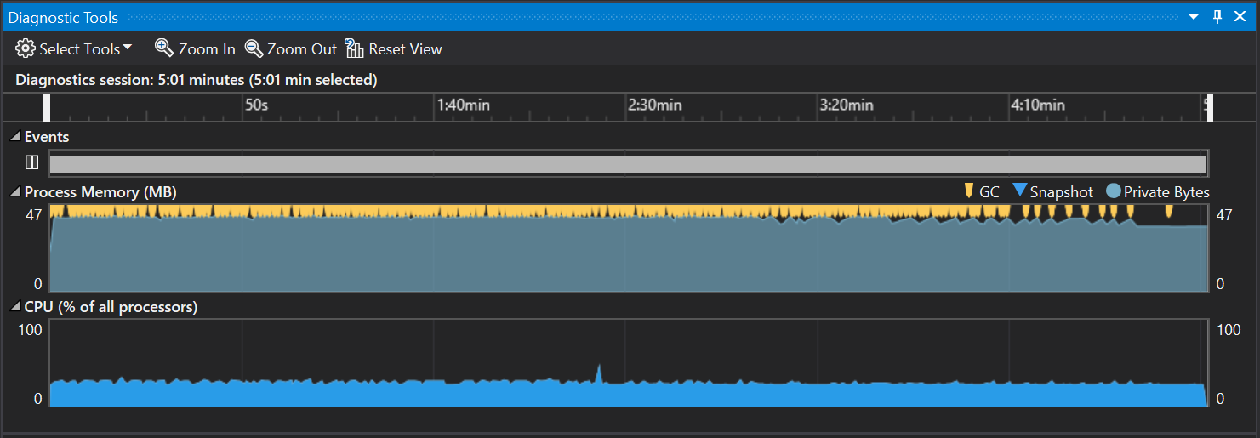
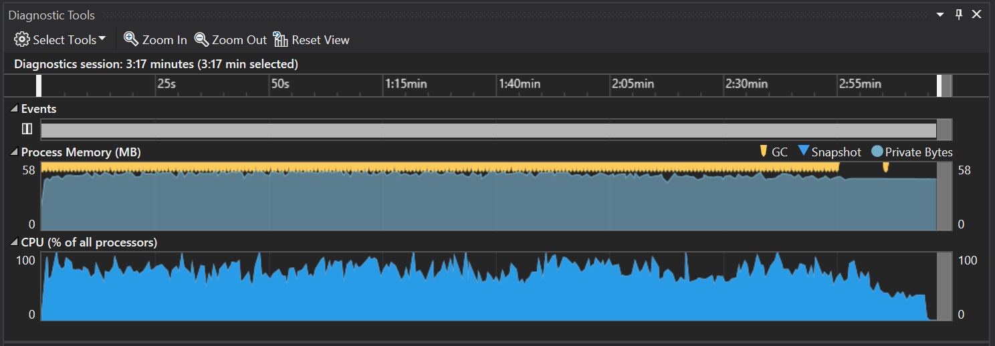
Optimization – Non-parallel vs parallel
Non-parallel
Parallel
Email-Enron, depth 2 (laptop)
53%
Email-Enron, depth 2 (laptop)
Notes:
Initialization of all CI values
Updating all CI values!!! -> heapifying subtrees

Slide 11
Optimization – CPU priority
Script
.exe file
High priority
Email-Enron, depth 2 (desktop)
 | Visual Studio w\ diagnostic tools | Visual Studio | Script
Time | 1 min 8,217 sec | 1 min 1,566 sec | 0 min 46,728 sec
32%
46%

Slide 12
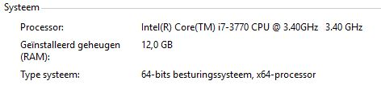
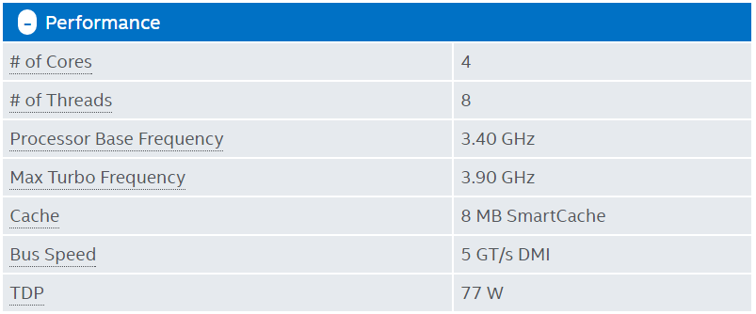
Results – PC info

Slide 13
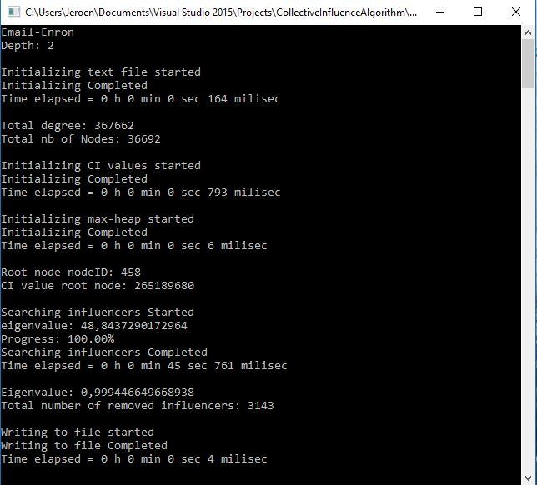
Results

Slide 14
Some results – Arxiv GR-QC Network
5 242 nodes
14 496 edges
 | Initializing | Searching influencers | TOTAL TIME | #influencers removed
CA-GrQc, depth 1 | 0 min 0,029 sec | 0 min 0,377 sec | 0 min 0,406 sec | 1412
CA-GrQc, depth 2 | 0 min 0,036 sec | 0 min 0,306 sec | 0 min 0,342 sec | 596
CA-GrQc, depth 3 | 0 min 0,056 sec | 0 min 0,800 sec | 0 min 0,856 sec | 524
CA-GrQc, depth 5 | 0 min 0,311 sec | 2 min 32,197 sec | 2 min 32,508 sec | 518
Notes:
Initialization: Reading text-file, calculating all CI, building max-heap
Searching influencers: Updating CI, heapifying and writing influencers to text-file

Slide 15
Some results – Arxiv GR-QC Network
Time (s)
Notes:
Initialization: Reading text-file, calculating all CI, building max-heap
Searching influencers: Updating CI, heapifying and writing influencers to text-file

Slide 16
Some results – Arxiv GR-QC Network
Time (s)
Notes:
Initialization: Reading text-file, calculating all CI, building max-heap
Searching influencers: Updating CI, heapifying and writing influencers to text-file

Slide 17
Some results – Email Enron
36 692 nodes
183 831 edges
 | Initializing | Searching influencers | TOTAL TIME | #influencers removed
Email Enron, depth 1 | 0 min 0,214 sec | 0 min 6,852 sec | 0 min 7,066 sec | 4079
Email Enron, depth 2 | 0 min 0,963 sec | 0 min 45,765 sec | 0 min 46,729 sec | 3143
Email Enron, depth 3 | 0 min 14,257 sec | 23 min 55,296 sec | 24 min 9,553 sec | 3057
Notes:
Initialization: Reading text-file, calculating all CI, building max-heap
Searching influencers: Updating CI, heapifying and writing influencers to text-file

Slide 18
Some results – Email Enron
Time (s)
Notes:
Initialization: Reading text-file, calculating all CI, building max-heap
Searching influencers: Updating CI, heapifying and writing influencers to text-file

Slide 19
Some results – Email Enron
Time (s)
Notes:
Initialization: Reading text-file, calculating all CI, building max-heap
Searching influencers: Updating CI, heapifying and writing influencers to text-file

Slide 20
Visualization
QuickGraph
Supports Graphviz
Writes graph to dot-file
Use script to render png-image
dot -Tpng C:\Users\Jeroen\Documents\Dotfiles\adjustedDotfile%1.dot -o "C:\Users\Jeroen\Documents\Dotfiles\adjustedDotfile%1.png
Notes:
%1 is parameter

